Slide 1
Assisting children while biking
Group members: Maximilian Hörnis, Florian Schwarm, Dennis Rupprecht

Slide 2
Motivation
Children are active participants in road traffic
Traffic signs might not be obvious to them
Handheld technology device (smartphones etc.) usage is prevalent among children

Slide 3
Idea
Recognize and classify traffic signs automatically and display them in an easy to understand assistive technology for children, without distracting them.

Slide 4

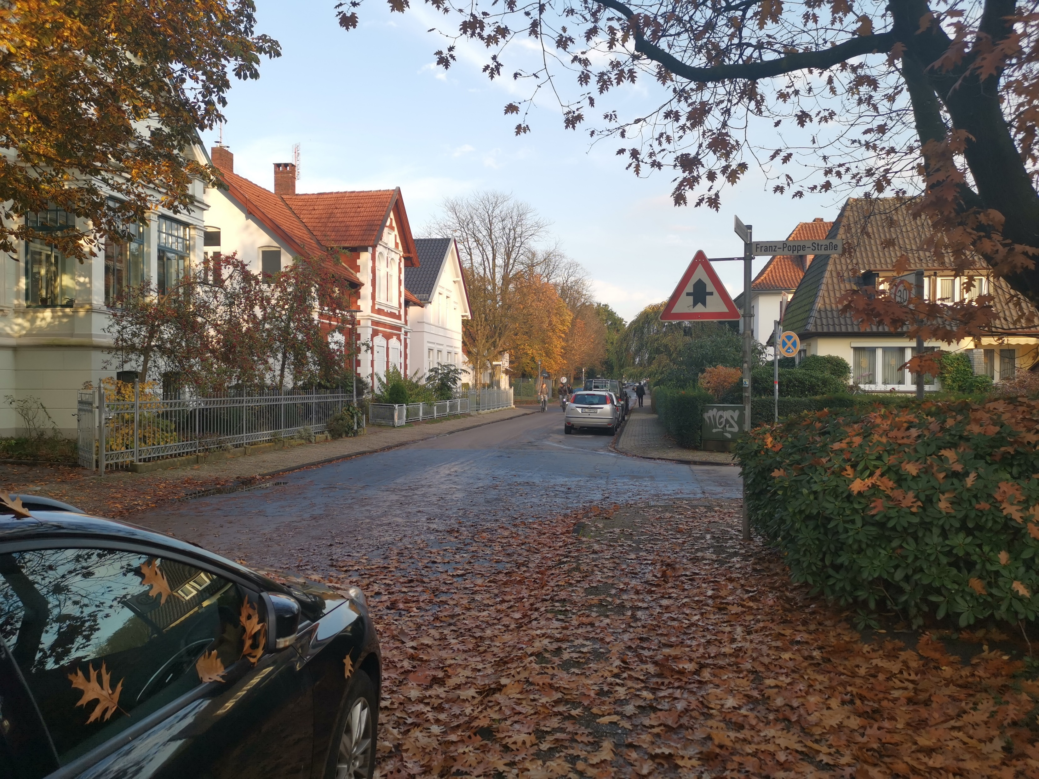

Idea - Example

Slide 5
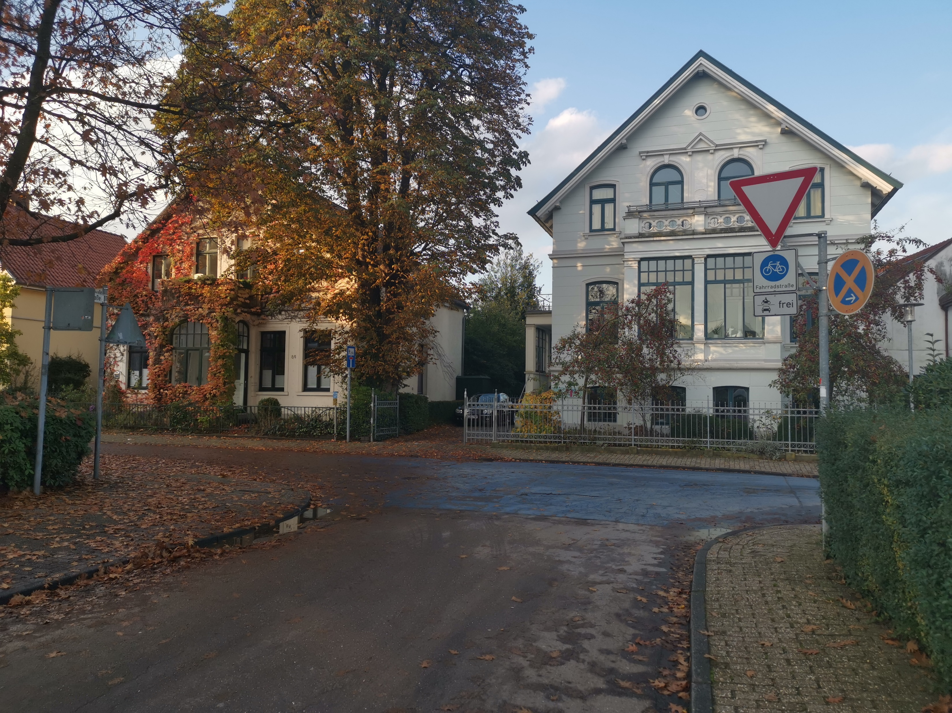

Idea - Example

Slide 6
Tasks
Recognizing and classifiying traffic signs
Interpretation of images in a way that is
sufficiently comprehensible for children and
not distracting.

Slide 7
Possible Extensions
Detection of intersections without relying on traffic signs
Detection of traffic lights and their current position (red, yellow, green)

Slide 8
Possible Extensions
Applying the traffic sign classifier to live video (or recordings)
Integrating the system into a mobile application

Slide 9
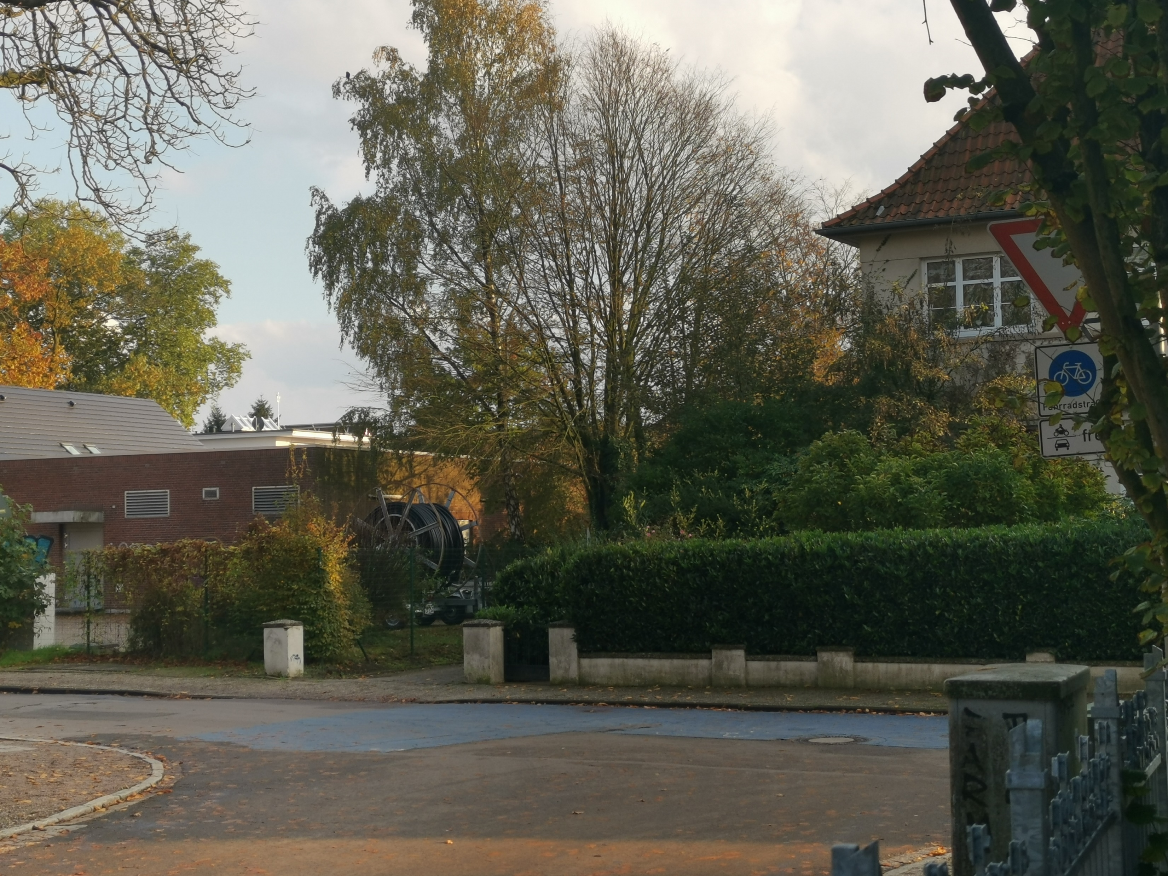
Possible Issues
?

Slide 10
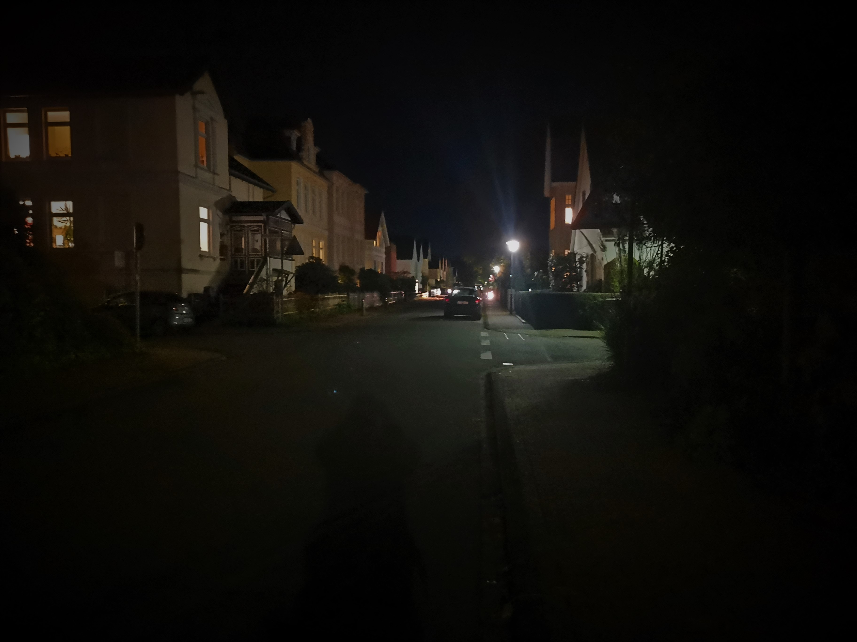
Possible Issues
?

Slide 11
Possible Issues
Recognizing dirty or occluded signs
Determining which street a sign refers to and how long it is valid
Reliable detection of intersections

Slide 12
Next Steps
Requirements
First experience with Jupyter and OpenCV

